Slide 1






GitHub Introduction
Workshop
Luis J. Chueca
RL3. Terrestrial Ecosystems
March 2024
luisjavier.chueca@bc3research.org
https://github.com/ljchueca
@LuisjaChueca
Notes:
NOTE to change the image inside the arrow select the image that comes out on the right side of the slide, then click on "replace image" then move the image to position it as you prefer with the arrow

Slide 2

Index
What is GitHub?
Create a repository
Synchronize to our Code Editor - RStudio
Commit changes
Compare and merge branches
Issues
Suggestions?

Slide 3
1.
What is GitHub?

Slide 4

1.
What is GitHub?

Slide 5


Let’s start from the beginning
hub
Git is a version control system that facilitates project management by acting as a repository for code modifications made.
A collaboration hub is a type of workspace designed to promote interaction, community, and teamwork
It allows: to check changes made
to consult and restore versions

Slide 6
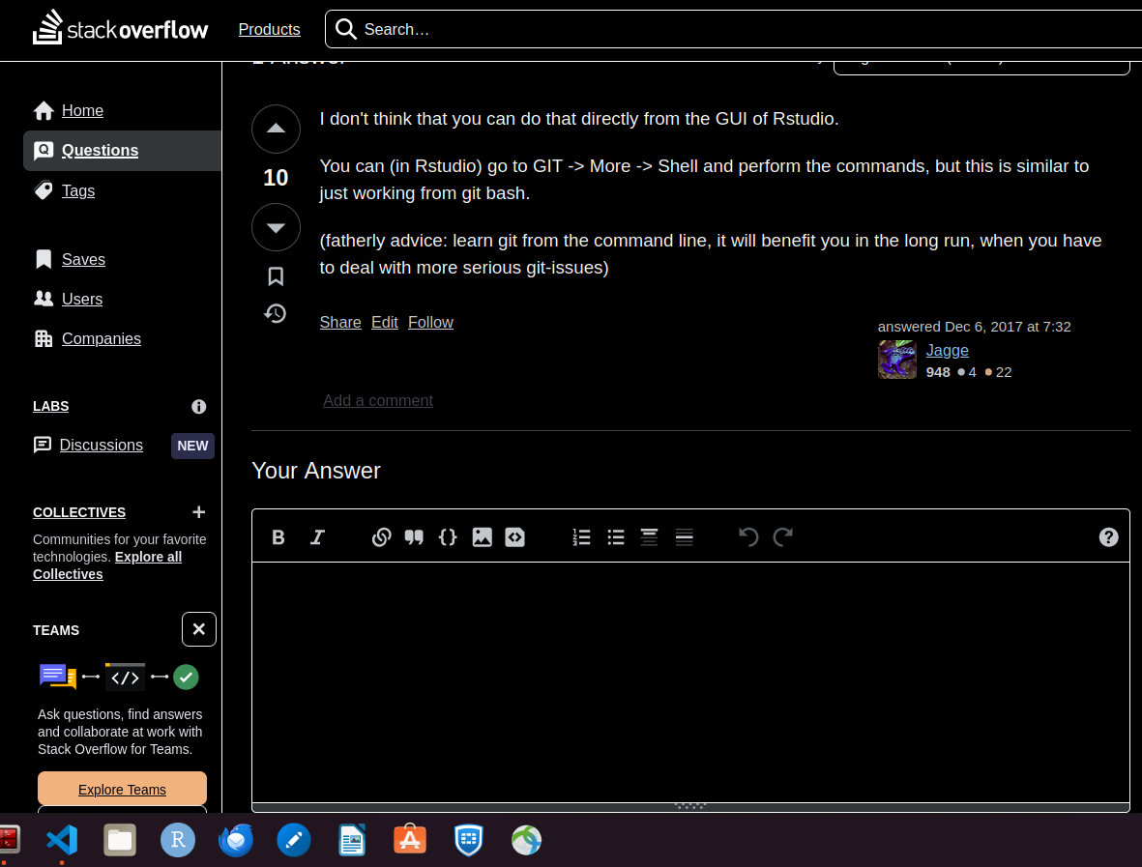
GitHub
GitHub is a cloud-based application development platform based on the Git code repository, which facilitates collaborative work.
Online platform: It’s an online version of Git. To correctly understand GitHub, you need first to understand Git.
Repository hosting: Allows to store and manage files and its versions from any device
Collaborative: Teammates (or external) can suggest modifications of you code
Issues tracking
Branching and merging between collaborators
Code review
more

Slide 7
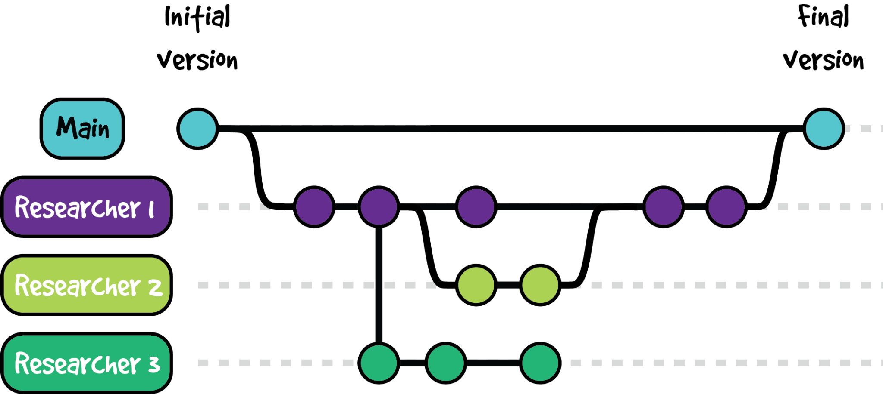

Git flow

Slide 8
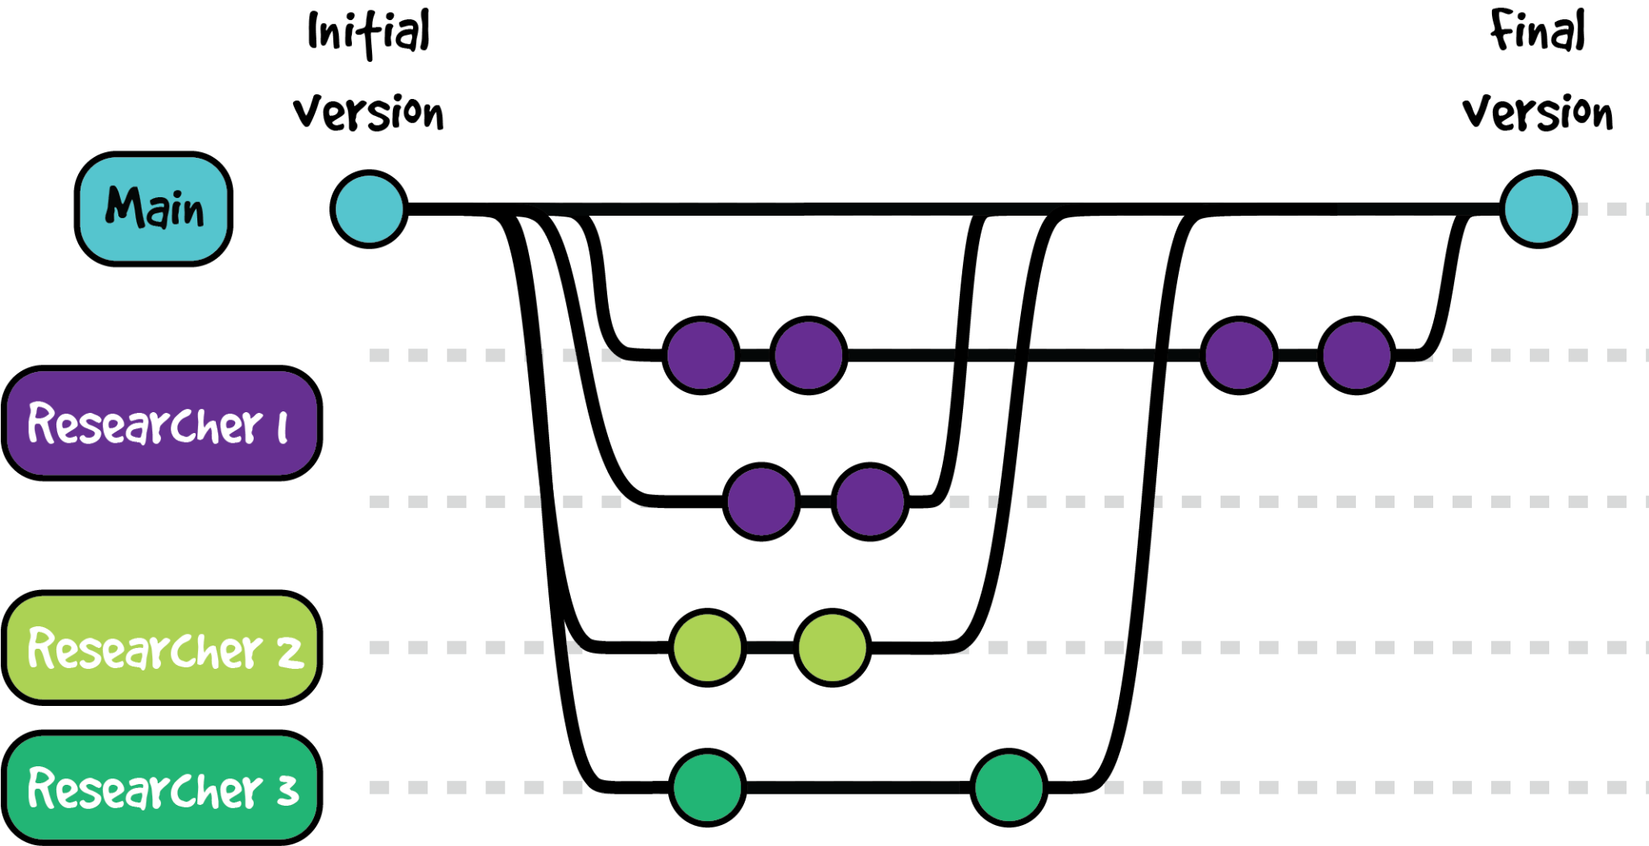
Git flow

Slide 9
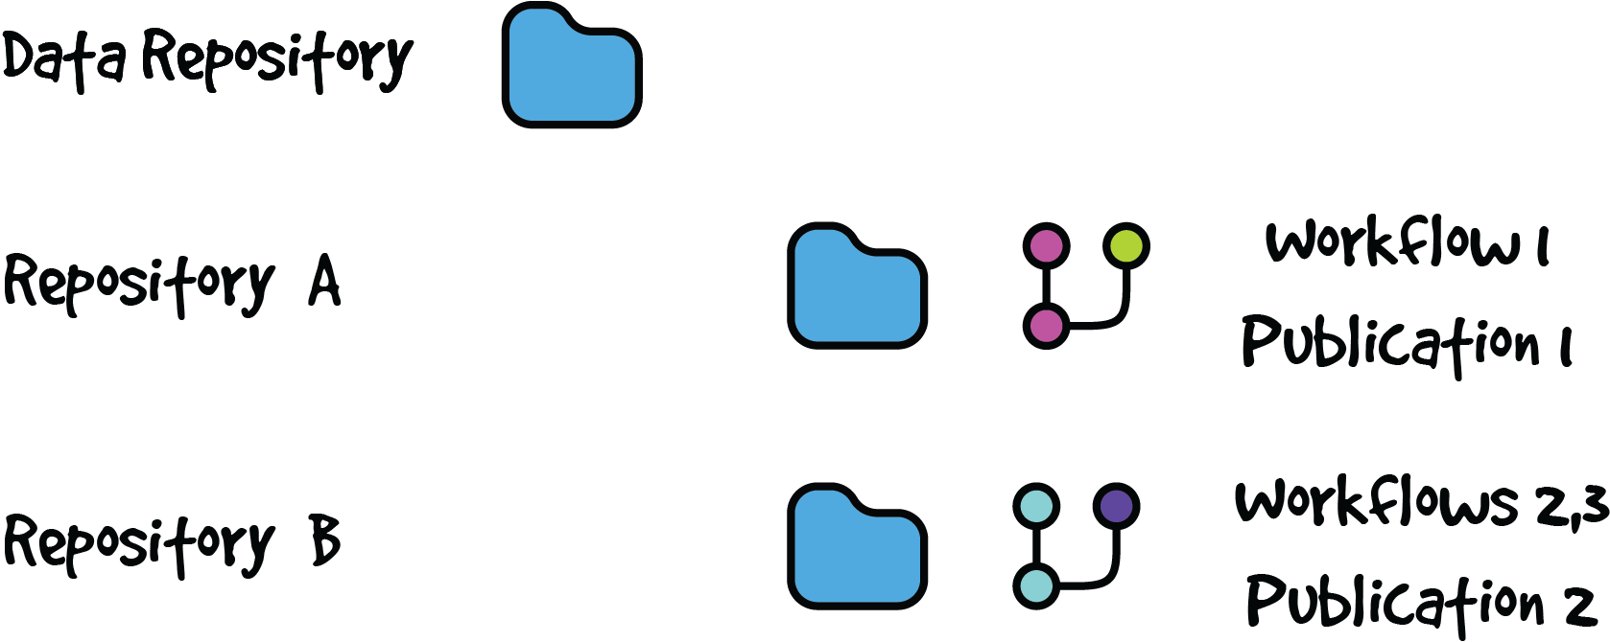
Organizations

Slide 10

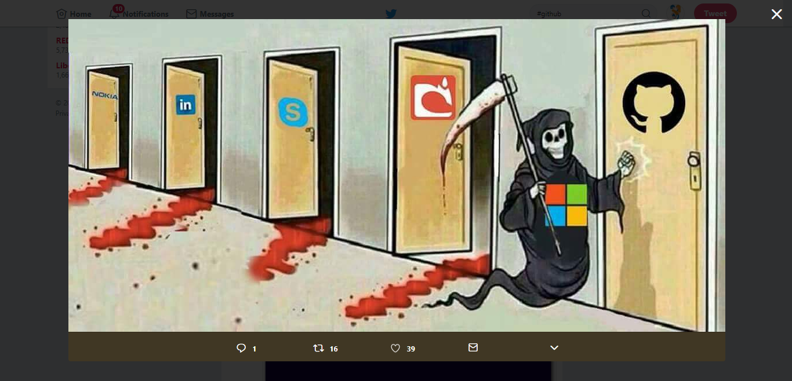
Launched in 2008
Purchased/Bought by Microsoft in 2018

Slide 11


Alternatives?
GitHub vs. GitLab: What’s the difference?
https://www.getclockwise.com/blog/github-vs-gitlab

Slide 12
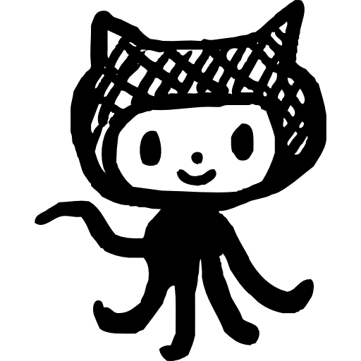
Disclaimer!
I have basic user GitHub skills
I work exclusively on GNU/Linux and Mac OS. I’m not Windows user
I don’t code in RStudio very often
but I’ll try to do my best!

Slide 13

Go to: https://github.com/ljchueca/BC3-git-workshop

Slide 14
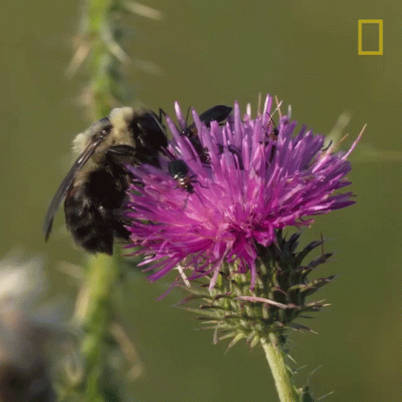
What we need?
GitHub personal account
Git installed in our computer
R and RStudio updated

Slide 15
2.
Creating a repository

Slide 16
Creating a repository
https://docs.github.com/en/repositories/creating-and-managing-repositories/creating-a-new-repository
Go to GitHub webpage
Click on a new repository button
Short and concise name
Avoid special characters and white spaces
Select between public or private
Add .gitignore and select R
Edit README file

Slide 17
3.
Synchronize GitHub with our Code Editor - RStudio

Slide 18
Connect GitHub with RStudio
Personal Access Token (PAT)
Sign in for GitHub
Create a PAT for GitHub. In RStudio
In the opened browser:
New personal access token -> create
Copy and save it
library(usethis) create_github_token()

Slide 19
Connect GitHub with RStudio
Sign in for GitHub
Create a PAT for GitHub. In RStudio
Store PAT to connect RStudio and GitHub. In RStudio
Personal Access Token (PAT)
library(gitcreds) gitcreds::gitcreds_set()

Slide 20
Clone a repository locally
Go to the repository url
Code -> Copy url to clipboard
In RStudio: File > New Project > Version Control > Git

Slide 21
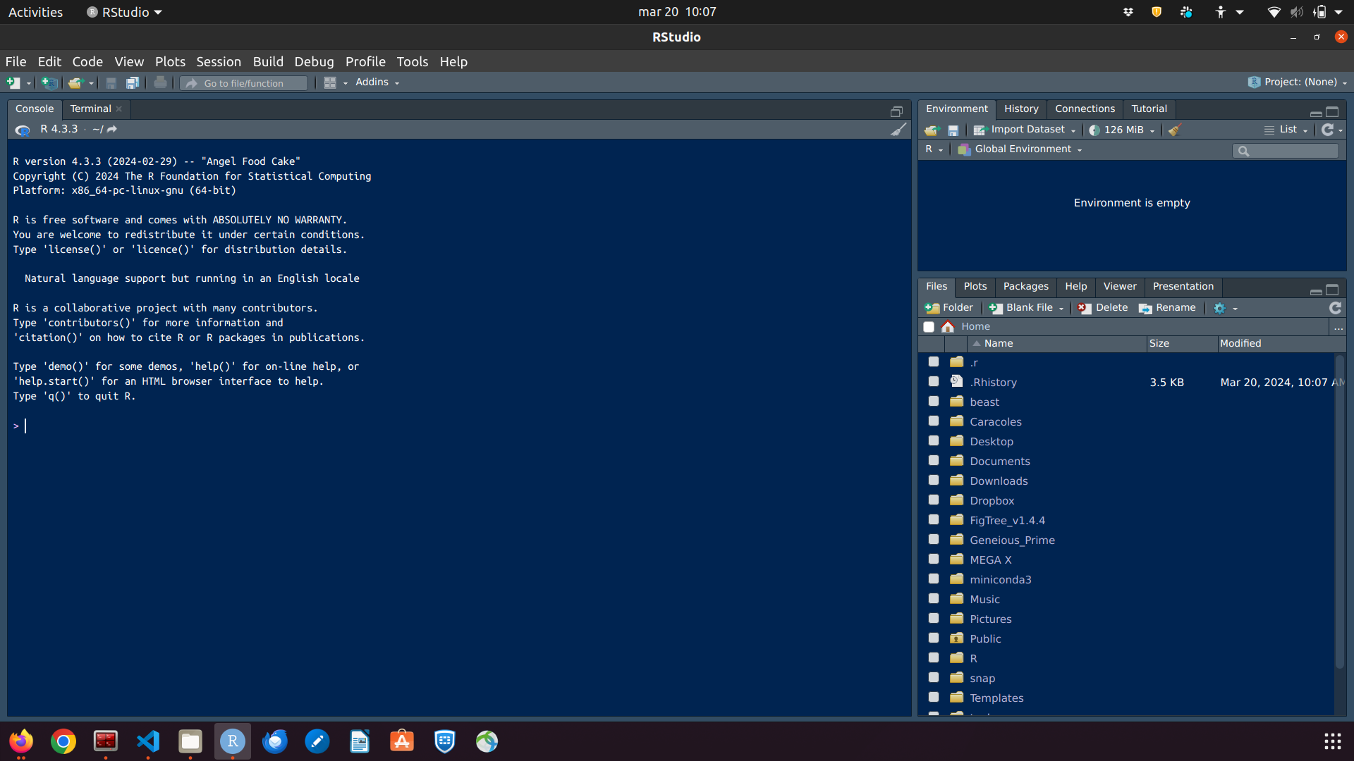
Clone a repository locally
Go to the repository url
Code -> Copy url to clipboard
In RStudio: File > New Project > Version Control > Git

Slide 22
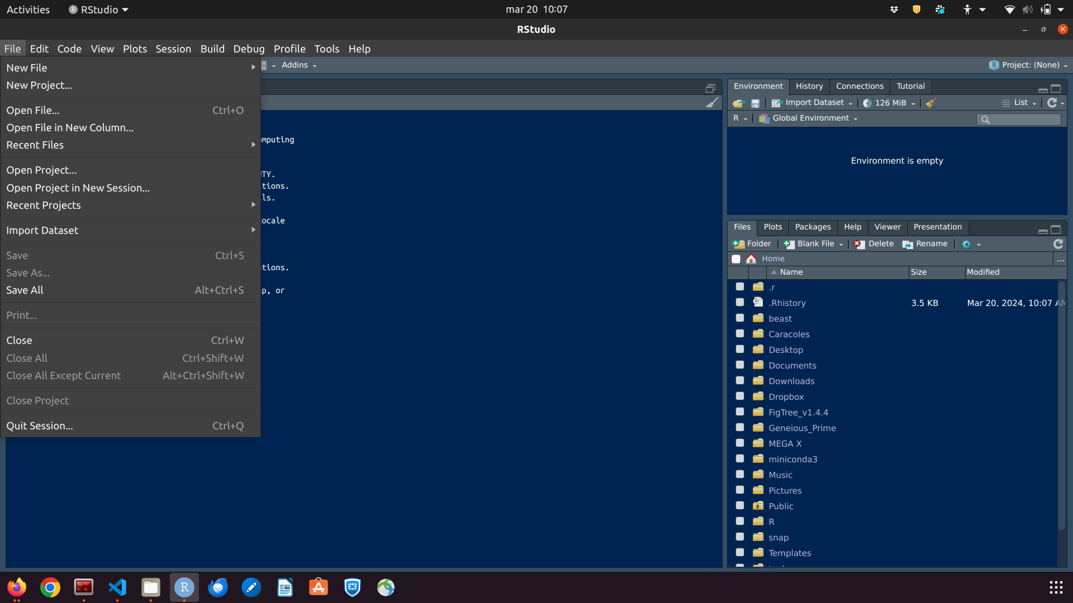
Clone a repository locally
Go to the repository url
Code -> Copy url to clipboard
In RStudio: File > New Project > Version Control > Git

Slide 23
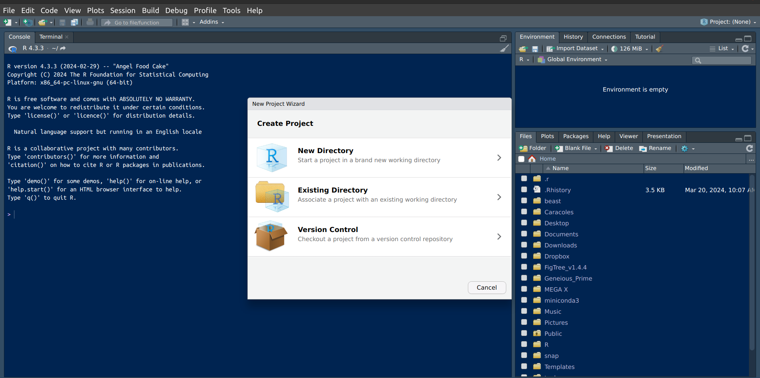
Clone a repository locally
Go to the repository url
Code -> Copy url to clipboard
In RStudio: File > New Project > Version Control > Git

Slide 24
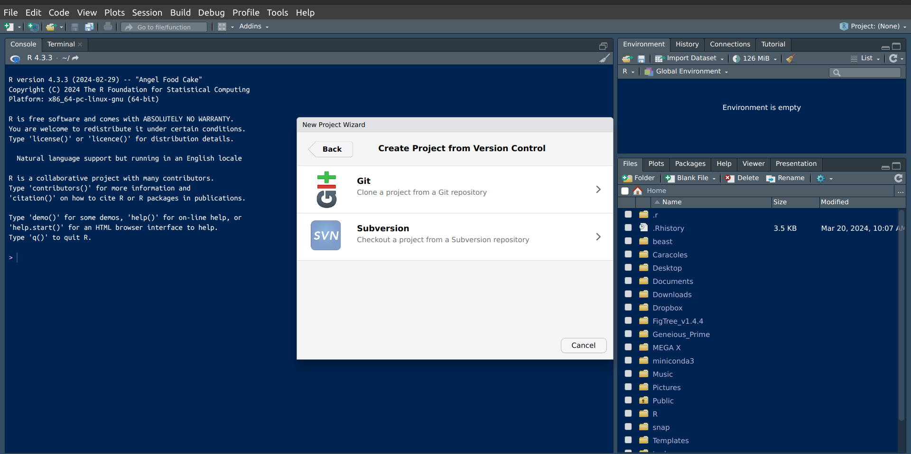
Clone a repository locally
Go to the repository url
Code -> Copy url to clipboard
In RStudio: File > New Project > Version Control > Git

Slide 25
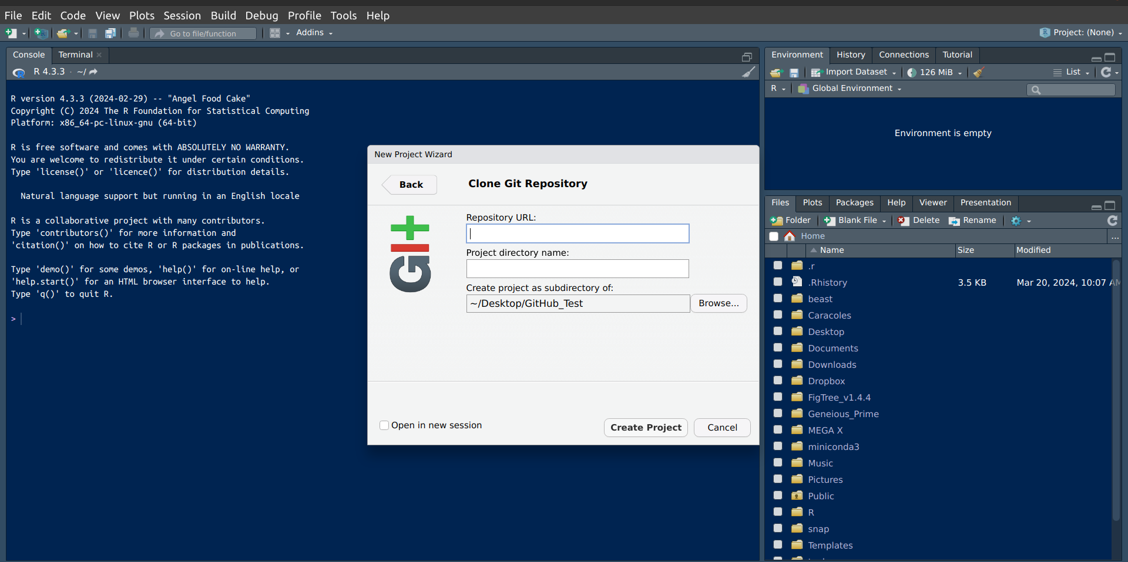
Clone a repository locally
Go to the repository url
Code -> Copy url to clipboard
In RStudio: File > New Project > Version Control > Git

Slide 26
Clone a repository locally
Go to the repository url
Code -> Copy url to clipboard
b) In Terminal
# Clone a GitHub repository git clone "url"

Slide 27
Create folders/directories
In GitHub webpage:
Add file
+ Create new file
write the folder/directory name and file name
e.g. ‘subfolder_a/.keep’
In the Terminal:
Create a directory (subfolder_a) and empty file (.keep)
Commit and push
# Create a directory mkdir 'NEW_DIRECTORY'
cd 'NEW_DIRECTORY' touch .keep

Slide 28
4.
Commit changes

Slide 29
# Check branches available git branch -a # Switch to any branch git checkout 'BRANCH NAME'
git status
Will tell you the branch you are on, the deleted, modified, created files, if the local commits are pushed, which changes are staged…
Stage the changes
git add 'FILE_TO_BE_STAGED'
git add . # Everything is added to be committed

Slide 30
Commit
# Commit Changes git commit -m "WRITE YOUR MESSAGE HERE" git pull git push

Slide 31
# Check branches available git branch -a # Switch to any branch git checkout 'BRANCH NAME'
# Commit Changes git status git pull git add 'FILE_TO_BE_STAGED'
git add . # Everything is added to be committed git commit -m "WRITE YOUR MESSAGE HERE" git pull git push

Slide 32
Check your commits and changes
# List Commits git log # or
git log --oneline # or
git reflog
You will see the SHA (Simple Hashing Algorithm = unique id of your commit), the author, date/time, commit message

Slide 33
Check your commits and changes
# List Commits git log # or
git log --oneline # or
git reflog
# See the changes of a commit
git show <SHA>
You will see the SHA (Simple Hashing Algorithm = unique id of your commit), the author, date/time, commit message

Slide 34
Undo commits
Different approaches
git reset # dangerous: you go back to the desired commit and "erase" all the commit created since.
git reset - - hard <SHA>
You can bypass
git reset --hard <previous-SHA>
git reset --soft <last-SHA>

Slide 35
5.
Compare and merge branches

Slide 36
# Switch to main branch git checkout main
# Merge branches to main
git merge 'BRANCH NAME' git status # Merge branches to main. If they are very different
git merge --allow-unrelated-histories 'BRANCH NAME' git commit -m "WRITE YOUR MESSAGE HERE" git pull git push

Slide 37
6.
Issues

Slide 38

Issues
New issue
Add a title
Add a description
Many different options
Preview
Submit new issue

Slide 39
7.
Discussion
Questions?
What did you expect?
Suggestions?

Slide 40


Thank you!

Slide 41
Connect Git with RStudio
https://anderfernandez.com/blog/como-vincular-y-usar-git-con-rstudio/
Create a SSH password in our computers: Mac, Linux or Windows
Add the SSH password to our GitHub account

